Slide 1
L2 Signals

Slide 2
ANALOG AND DIGITAL DATA
Data can be analog or digital.
The term analog data refers to information that is continuous;
digital data refers to information that has discrete states.
Analog data take on continuous values. Digital data take on discrete values.
Data: Entities that convey meaning or information

Slide 3
Analog and Digital Signals
Signals can be analog or digital.
Analog signals can have an infinite number of values in a range.
Digital signals can have only a limited number of values.

Slide 4
Analog and Digital Signals
Electric or electromagnetic representations of data
Analog signal is continuously varying electromagnetic wave
Digital signal is sequence of voltage pulses
Digital signals generally cheaper and less effected by disturbances (noise)
Digital signals suffer more from signal weakening (attenuation)

Slide 5
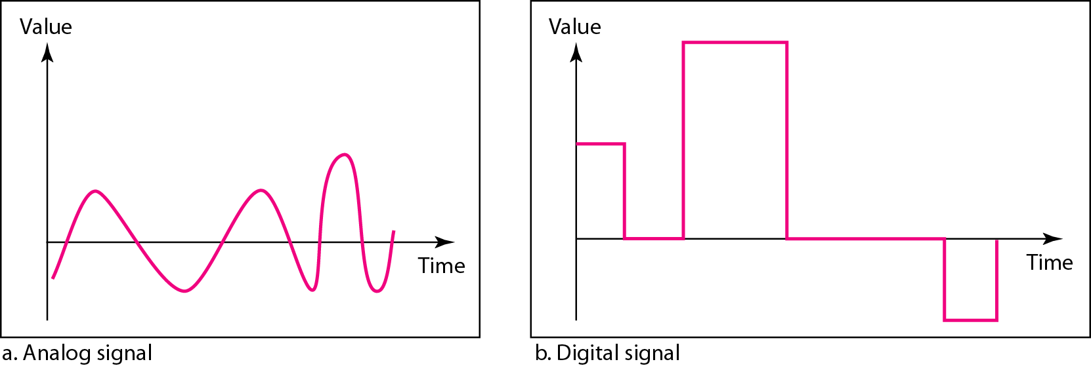
Figure 3.1 Comparison of analog and digital signals

Slide 6
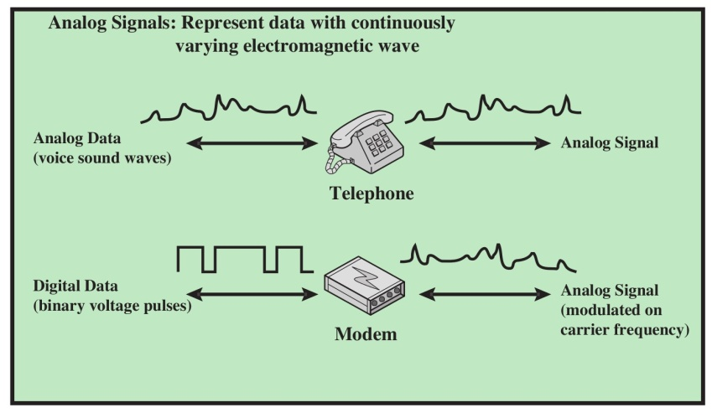
Analog Signaling of Analog and Digital Data

Slide 7
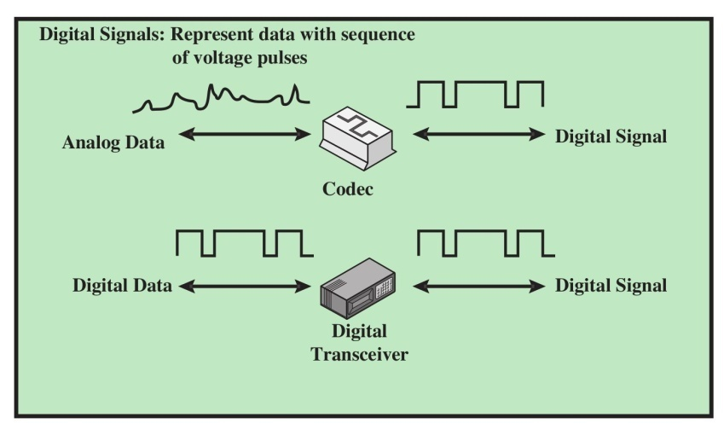
Digital Signaling of Analog and Digital Data
a device that can both transmit and receive communications
A codec is a device or computer program which encodes or decodes a data stream or signal.

Slide 8
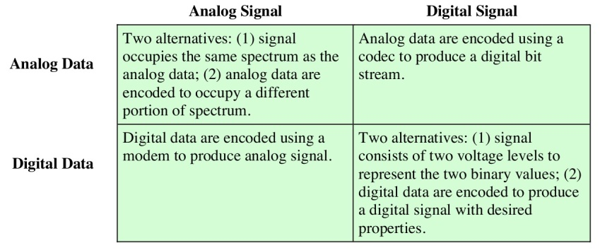
Ananlog/Digital Signals and Data
Spectrum refers to the invisible radio frequencies that wireless signals travel over.

Slide 9
Analog vs Digital Transmission
Analog transmission: analog signal is propagated through amplifiers
Digital transmission: digital signals are propagated through repeaters
Digital transmission is preferred technology today: digital equipment, efficiently combine signals from different sources; security; repeaters can give more accurate data transmission

Slide 10
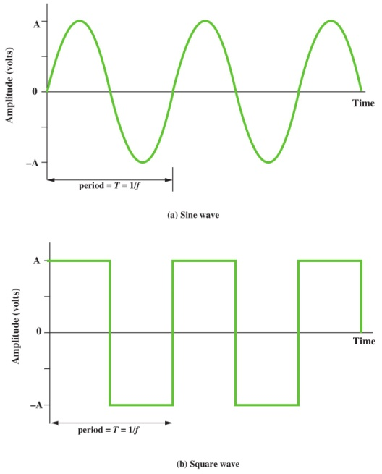
Examples of Periodic Signals
Any signal is either periodic (the following two) or aperiodic

Slide 11

Examples of aperiodic signals

Slide 12
3-2 PERIODIC ANALOG SIGNALS
In data communications, we commonly use periodic analog signals and nonperiodic digital signals.
Periodic analog signals can be classified as simple or composite. A simple periodic analog signal, a sine wave, cannot be decomposed into simpler signals.
A composite periodic analog signal is composed of multiple sine waves.

Slide 13
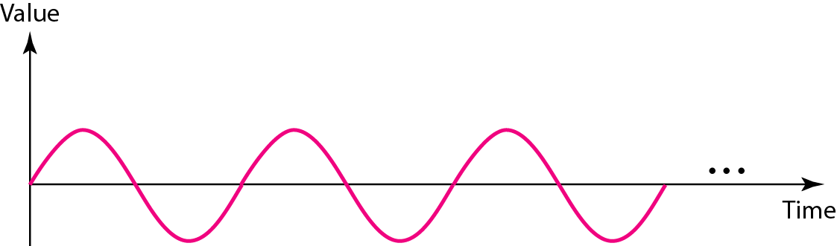
Figure 3.2 A sine wave

Slide 14
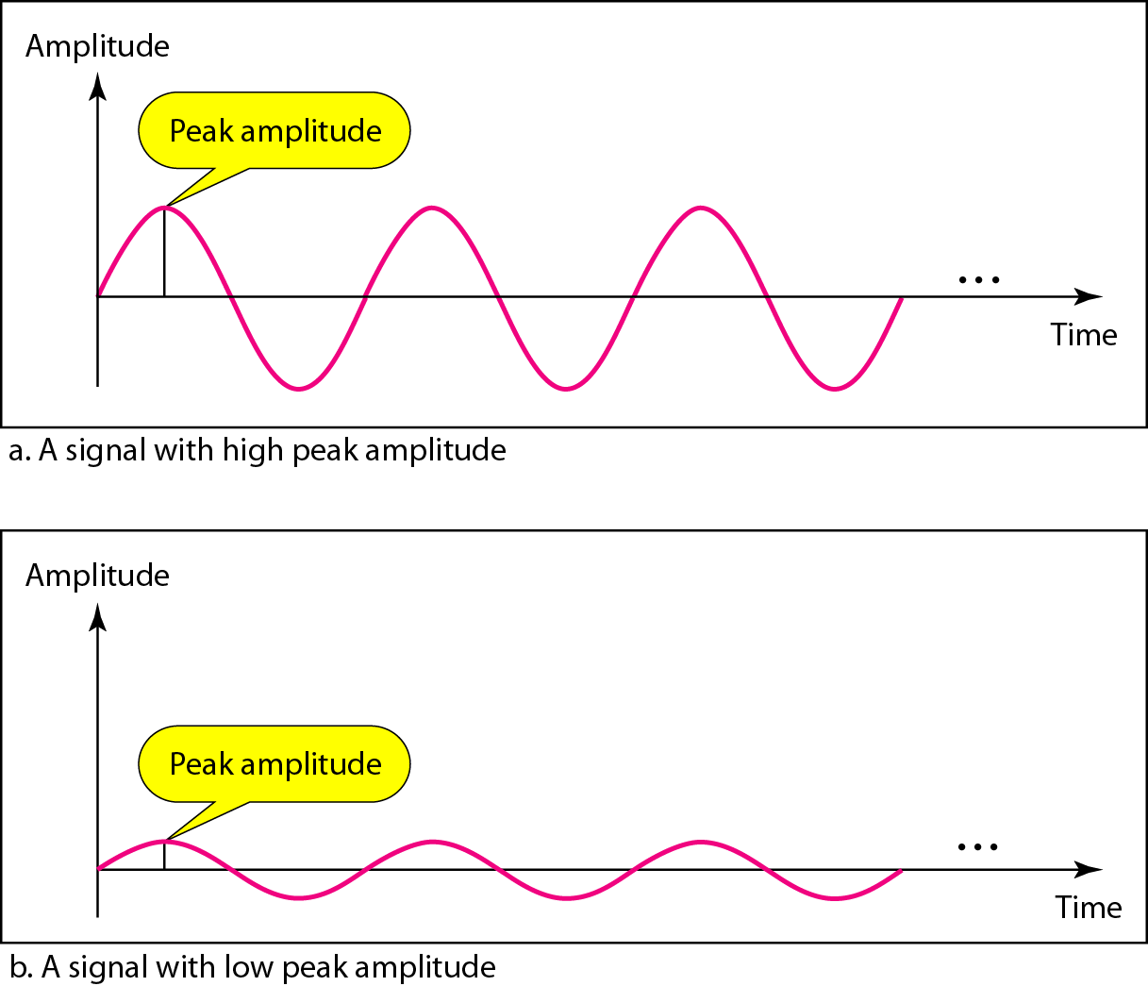
Figure 3.3 Two signals with the same phase and frequency, but different amplitudes

Slide 15
Frequency
Frequency is the rate of change with respect to time.
Change in a short span of time means high frequency.
Change over a long span of time means low frequency.
If a signal does not change at all, its frequency is zero.
If a signal changes instantaneously, its frequency is infinite.

Slide 16


Note
Frequency and period are the inverse of each other.

Slide 17
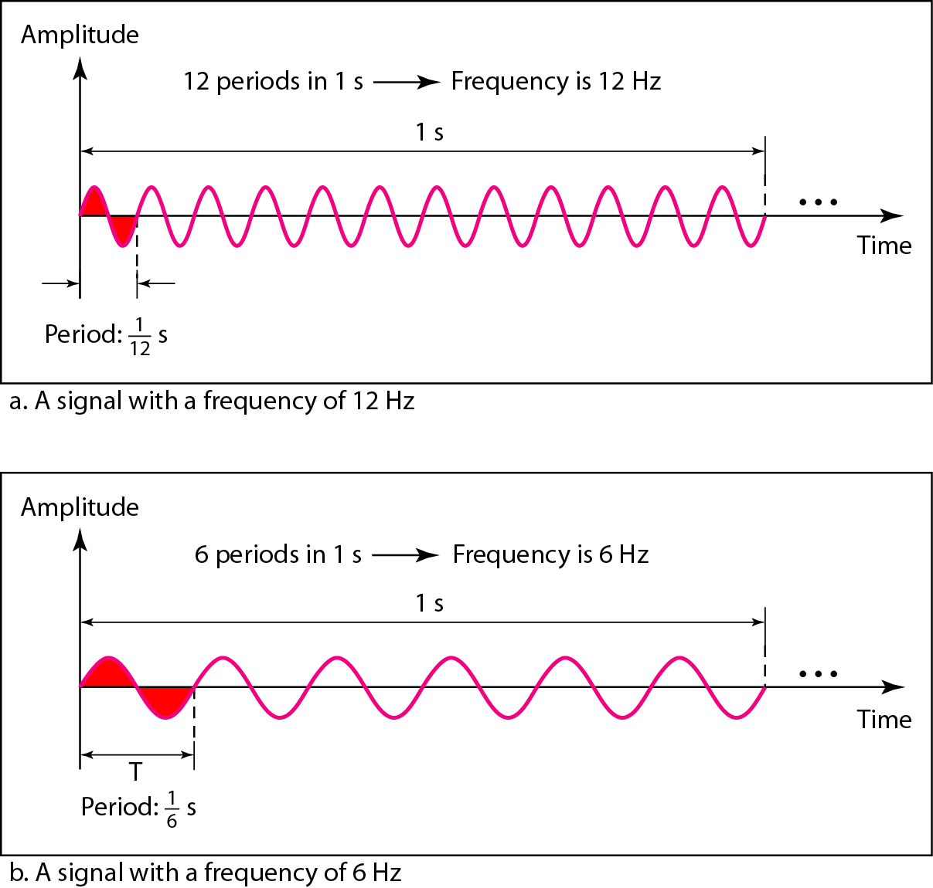
Figure 3.4 Two signals with the same amplitude and phase, but different frequencies

Slide 18
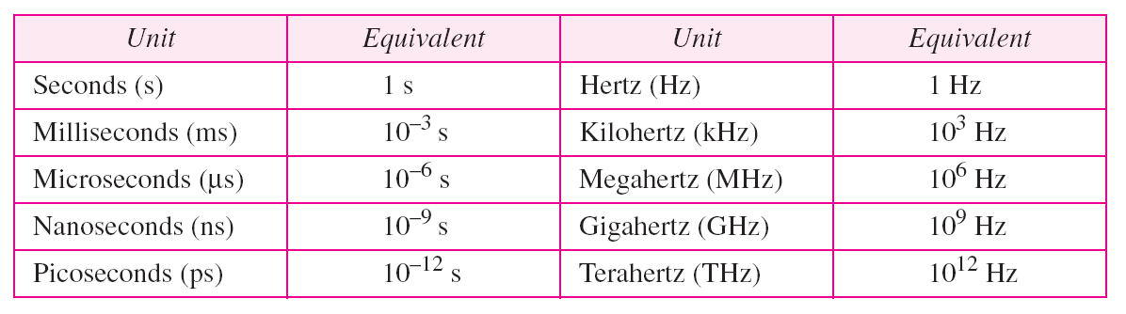
Table 3.1 Units of period and frequency

Slide 19
Example 3.1
The power we use at home has a frequency of 60 Hz. The period of this sine wave can be determined as follows:

Slide 20
Example 3.2
The period of a signal is 100 ms. What is its frequency in kilohertz?
Solution
First we change 100 ms to seconds, and then we calculate the frequency from the period (1 Hz = 10⁻³ kHz).

Slide 21
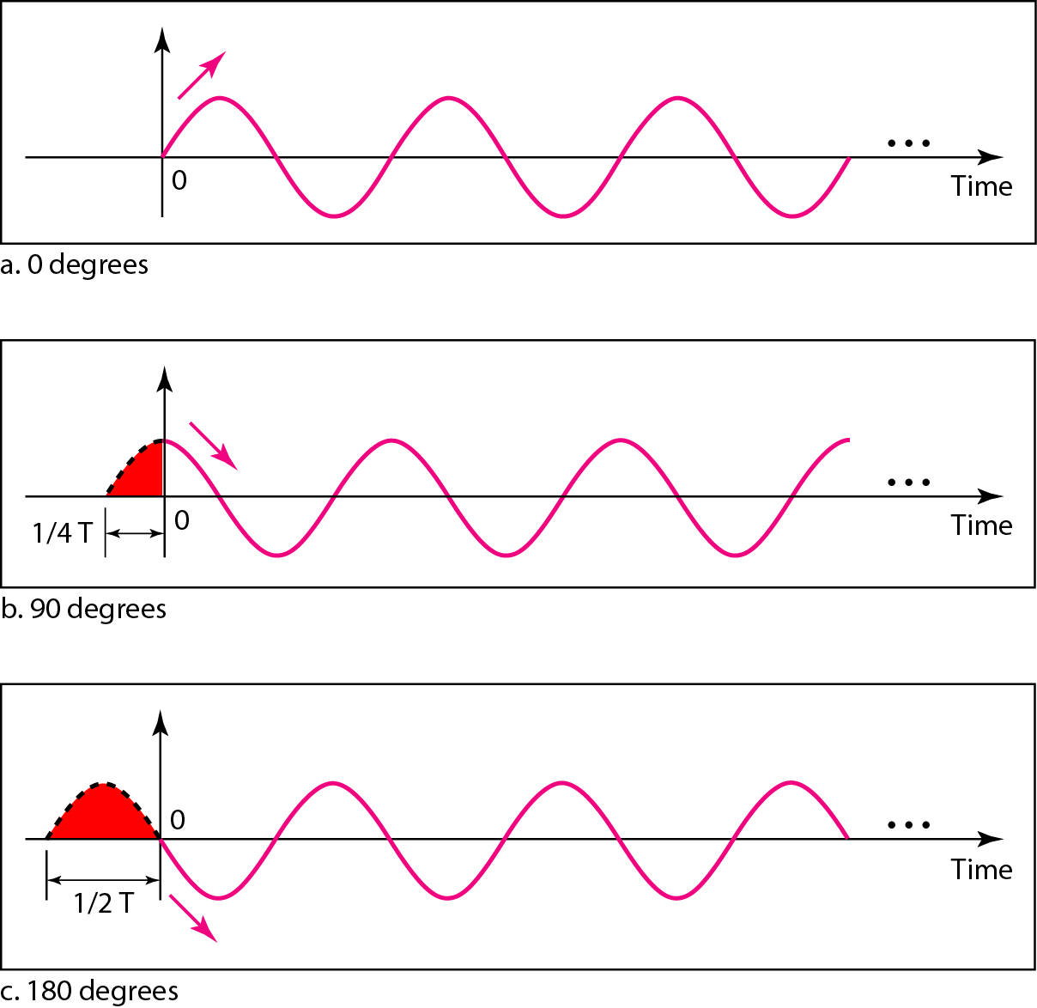
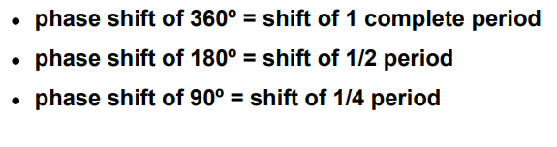
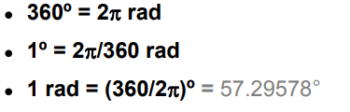
Figure 3.5 Three sine waves with the same amplitude and frequency, but different phases
Phase describes the position of the waveform relative to time 0.

Slide 22
Example 3.3
A sine wave is offset 1/6 cycle with respect to time 0. What is its phase in degrees and radians?
Solution
We know that 1 complete cycle is 360°. Therefore, 1/6 cycle is

Slide 23
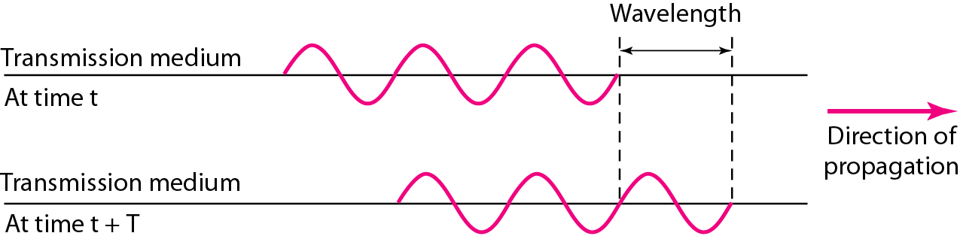


Figure 3.6 Wavelength and period
Wavelength refers to the distance between two identical points of neighboring cycles of a wave signal
While the frequency of a signal is independent of the medium, the wavelength depends on both the frequency and the medium.
The wavelength is the distance a simple signal can travel in one period. (usually, unit of measurement is meters)

Slide 24
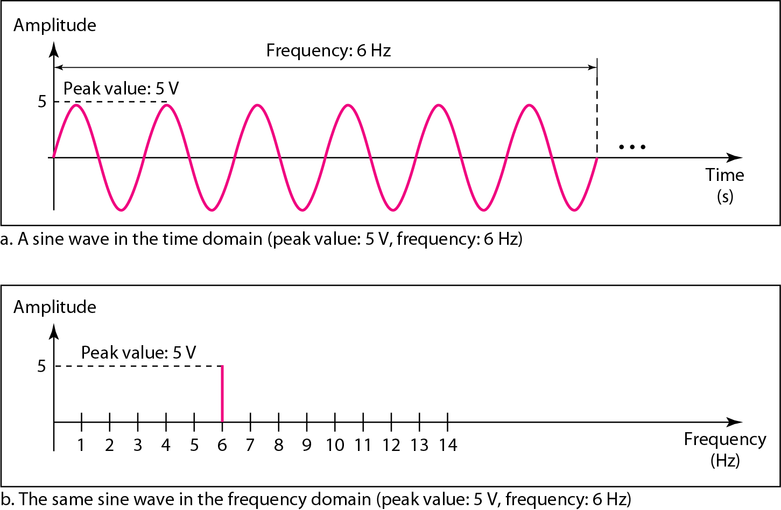
Figure 3.7 The time-domain and frequency-domain plots of a sine wave
A complete sine wave in the time domain can be represented by one single spike in the frequency domain

Slide 25
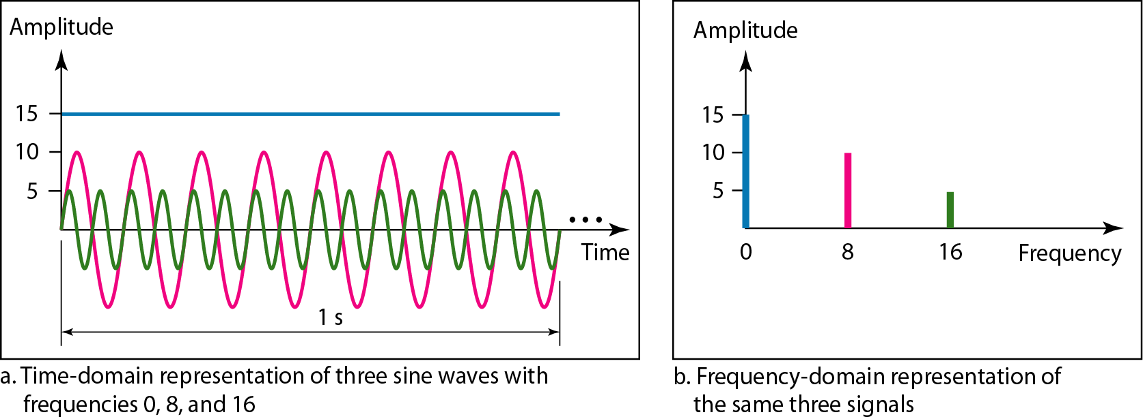
Figure 3.8 The time domain and frequency domain of three sine waves
frequency domain is more compact and useful when we are dealing with more than one sine wave

Slide 26
Signals and Communication
A single-frequency sine wave is not useful in data communications
We need to send a composite signal, a signal made of many simple sine waves.
According to Fourier analysis, any composite signal is a combination of simple sine waves with different frequencies, amplitudes, and phases.

Slide 27
Composite Signals and Periodicity
If the composite signal is periodic, the decomposition gives a series of signals with discrete frequencies.
If the composite signal is nonperiodic, the decomposition gives a combination of sine waves with continuous frequencies.

Slide 28
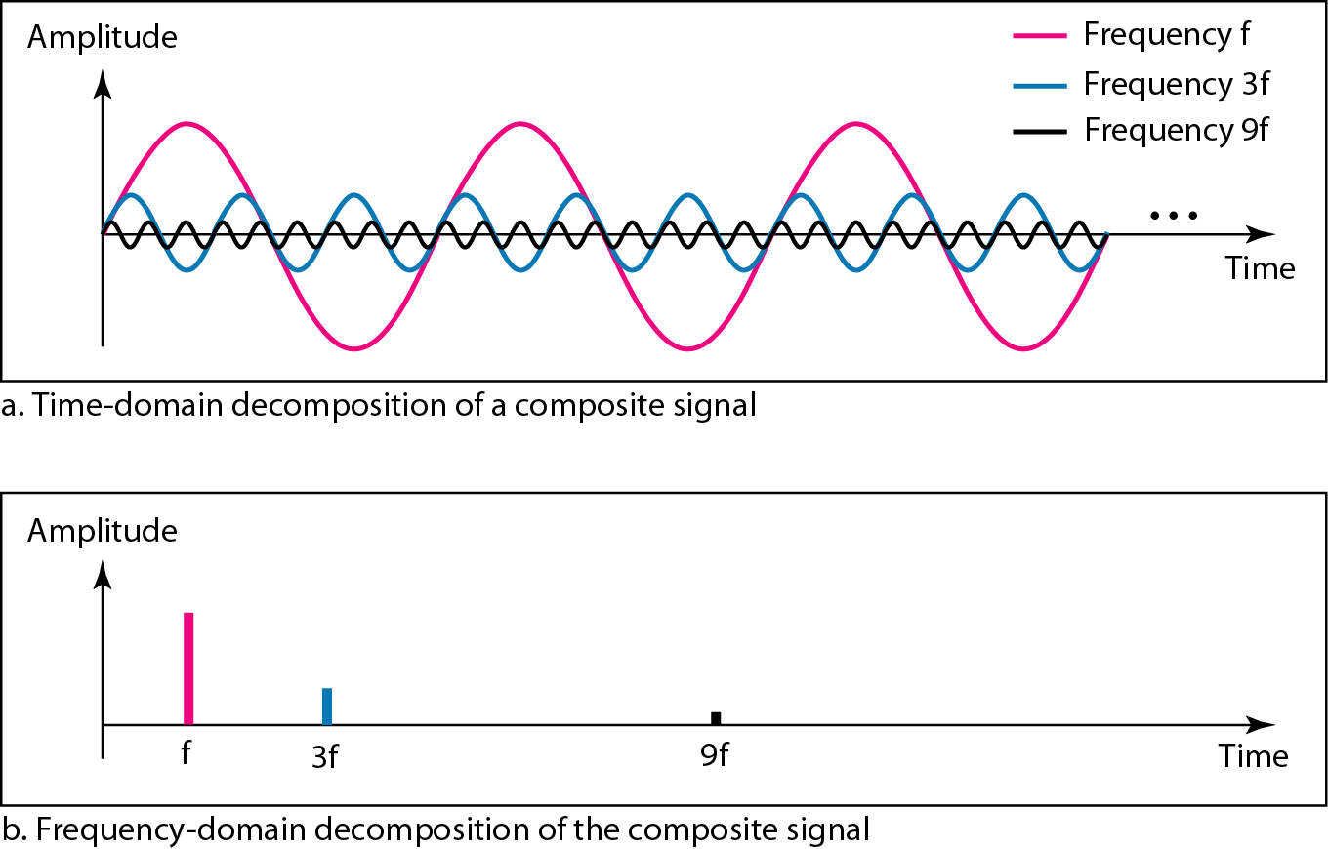
Figure 3.10 Decomposition of a composite periodic signal in the time and frequency domains

Slide 29
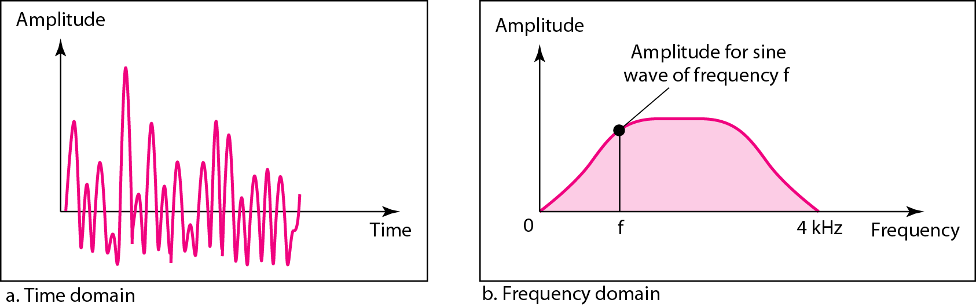
Figure 3.11 The time and frequency domains of a nonperiodic signal

Slide 30
Spectrum and Bandwidth
The spectrum of a signal is the range of frequencies contained in the signal.
The bandwidth is the difference between the lowest and highest frequency in the spectrum.
Bandwidth is subset of Spectrum

Slide 31
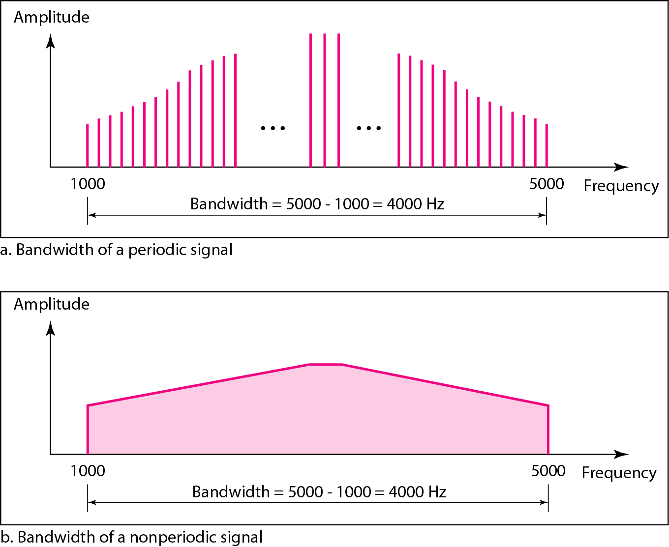
Figure 3.12 The bandwidth of periodic and nonperiodic composite signals

Slide 32
Example 3.6
If a periodic signal is decomposed into five sine waves with frequencies of 100, 300, 500, 700, and 900 Hz, what is its bandwidth? Draw the spectrum, assuming all components have a maximum amplitude of 10 V.
Solution
Let f_{h} be the highest frequency, f_{l} the lowest frequency, and B the bandwidth. Then
The spectrum has only five spikes, at 100, 300, 500, 700, and 900 Hz (see Figure 3.13).

Slide 33
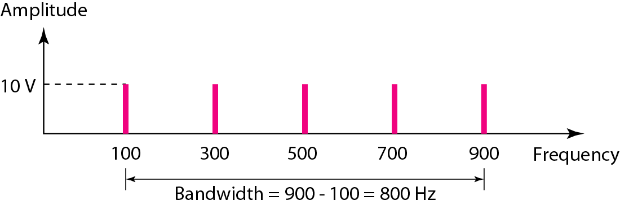
Figure 3.13 The bandwidth for Example 3.6
Notes:
This is discrete spectrum of a periodic signal

Slide 34
Example 3.7
A periodic signal has a bandwidth of 20 Hz. The highest frequency is 60 Hz. What is the lowest frequency? Draw the spectrum if the signal contains all frequencies of the same amplitude.
Solution
Let f_{h} be the highest frequency, f_{l} the lowest frequency, and B the bandwidth. Then
The spectrum contains all integer frequencies. We show this by a series of spikes (see Figure 3.14).

Slide 35
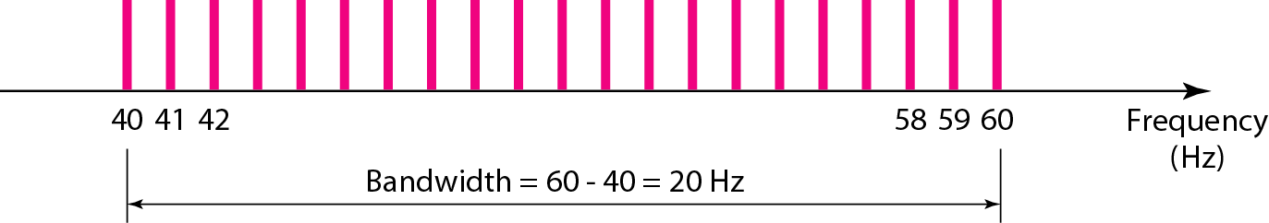
Figure 3.14 The bandwidth for Example 3.7

Slide 36
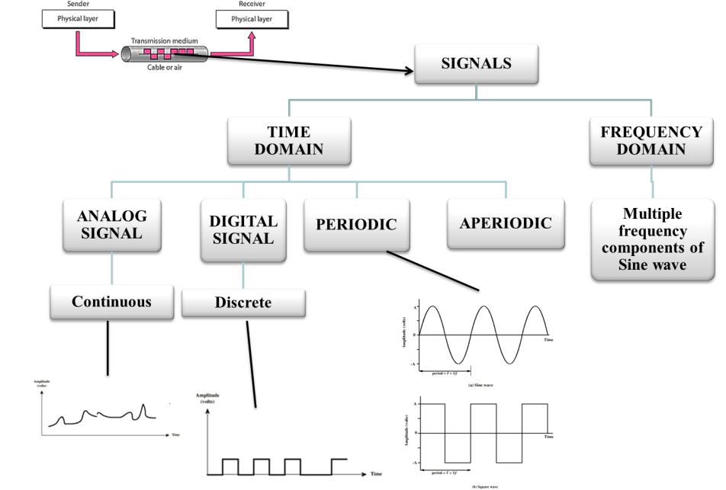

Slide 37
Composite Signals
A composite signal can be periodic or nonperiodic.
A periodic composite signal can be decomposed into a series of simple sine waves with discrete frequencies that have integer values (1, 2, 3, and so on).
A nonperiodic composite signal can be decomposed into a combination of an infinite number of simple sine waves with continuous frequencies, frequencies that have real values.
.

Slide 38
Representation of sine wave
Periodic analog signal characterized by 3 parameters.[Amplitude :A, Frequency: f and Phase φ]
Representation of sine wave
s (t) = A sin (2πft + φ)
Where A is peak amplitude.
.

Slide 39
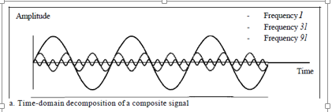
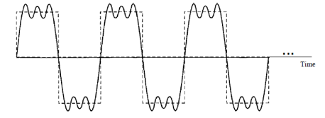
Composite Signals
The amplitude of the sine wave with frequency f is almost the same as the peak amplitude of the composite signal.
The amplitude of the sine wave with frequency 3f is one-third of that of the first, and the amplitude of the sine wave with frequency 9f is one-ninth of the first.
.

Slide 40
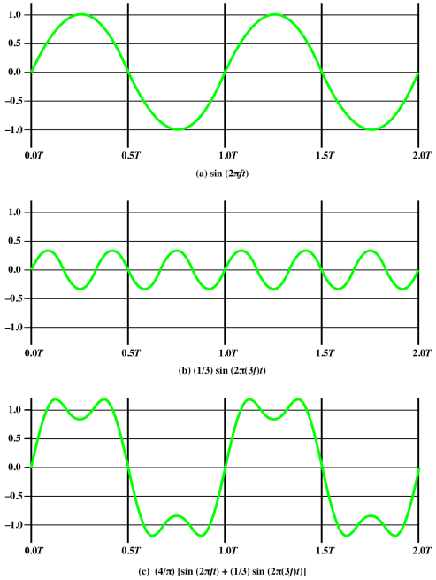
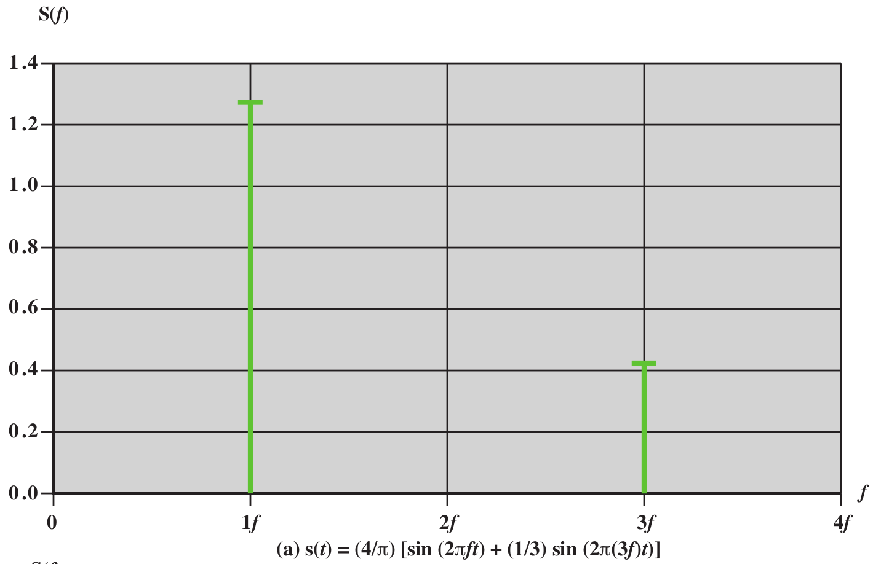
.

Slide 41
Composite Signals
The frequency of the sine wave with frequency f is the same as the frequency of the composite signal; it is called the fundamental frequency, or first harmonic.
The sine wave with frequency 3f has a frequency of 3 times the fundamental frequency; it is called the third harmonic.
The third sine wave with frequency 9fhas a frequency of 9 times the fundamental frequency; it is called the ninth harmonic.
Composite signals can be expressed as a combination of simple sine waves with different amplitude, frequency and phase.
s (t ) = A₁ sin (2πf₁t + φ₁) + A₂ sin (2πf₂t + φ₂) + A₃ sin (2πf₃t + φ₃) +……..
.

Slide 42
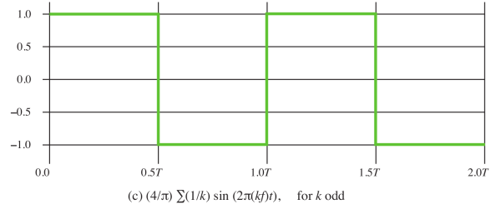
Digital signal
Most digital signals are nonperiodic(10000011110010101)
period and frequency are not appropriate characteristics.
Bit interval
Time required to send a single bit.
.

Slide 43
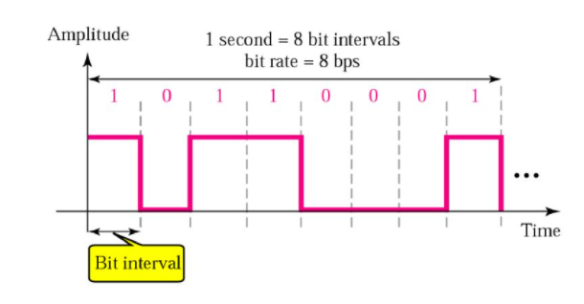
Digital signal
Bit Rate
Number of bits sent in 1 second, expressed in bits per second (bps).
Number of bit intervals per second.
.

Slide 44
Digital Signals
Bit interval(T): It is the time required to send a single bit.
Bit rate: It is number of bit intervals per second.(1/T)
Propagation time: It is the time required for signal to travel from one point of transmission medium to another.
Propagation time=Distance/ Propagation speed

Slide 45
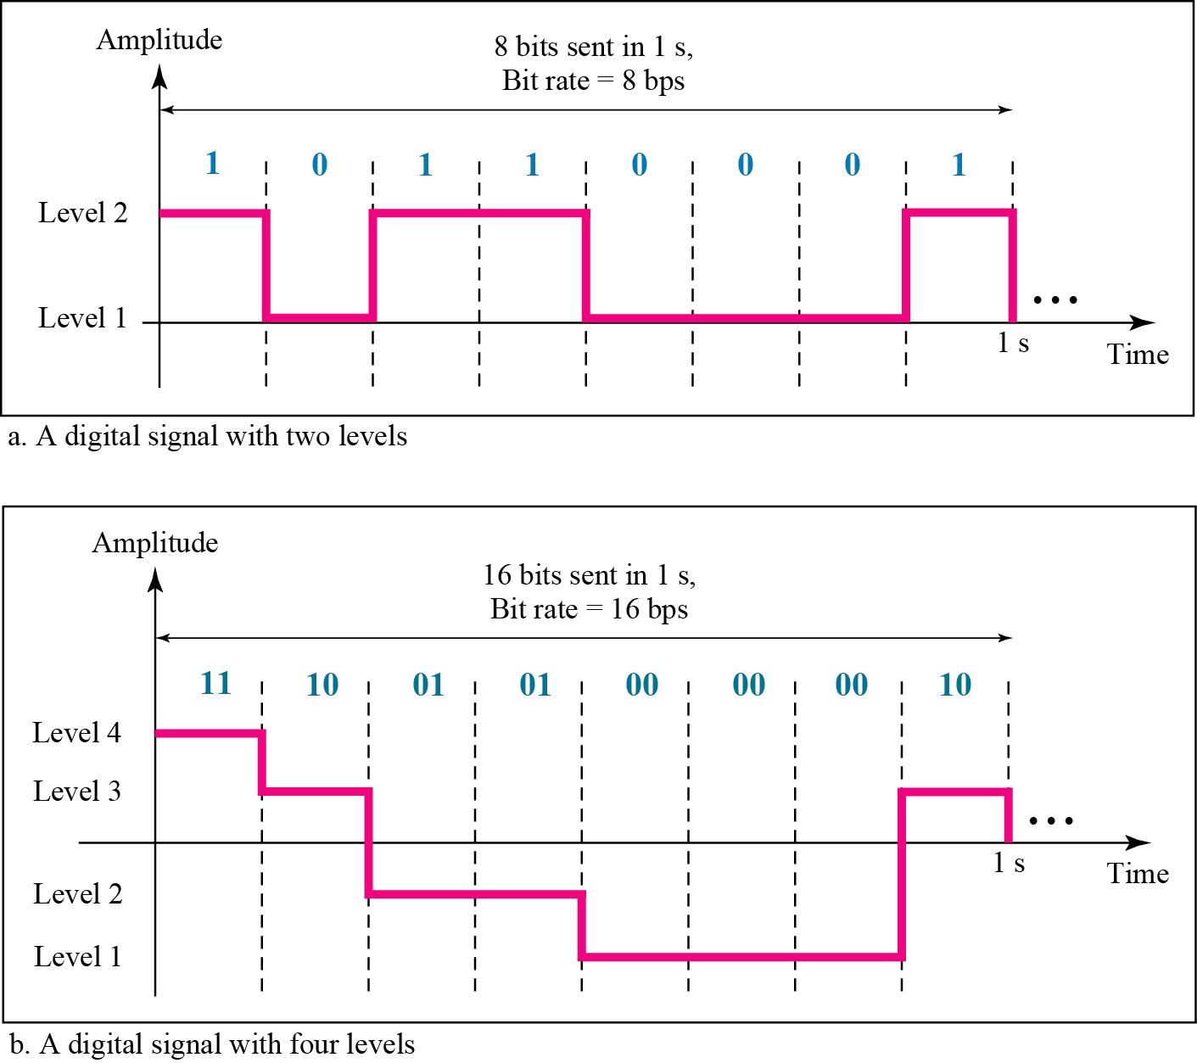
Digital signal
In general, if a signal has L levels, each level needs log2L bits.
A digital signal can have more than two levels.
In this case, we can send more than 1 bit for each level.
.

Slide 46
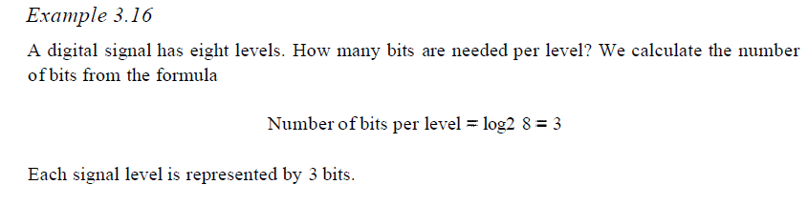
Example 3.17
A digital signal has nine levels. How many bits are needed per level?
Each signal level is represented by 3.17 bits.
4 bits can represent one level.

Slide 47
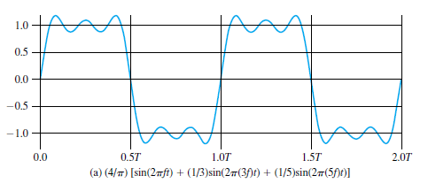
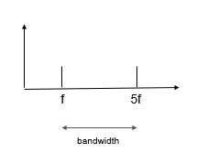
Case 1:
Let f be 1MHz
Bandwidth = (5x10^6)-(1x10^6) = 4MHz
T=1/f=1/(10^6)=1x(10^-6)s=1μsecs

Slide 48
Case 2:
Let f be 2MHz
Bandwidth = (5x2x10^6)-(2x10^6) = 8MHz
T=1/f=1/(2x10^6)=1x(2x10^-6)s=0.5μsecs

Slide 49
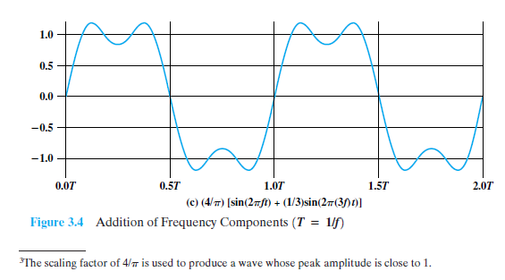
Case 3:
Let frequency(f) be 2MHz
Bandwidth = (3x2x10^6)-(2x10^6) = 4MHz
Period(T)=1/f=1/(2x10^6)=1x(2x10^-6)s=0.5μsecs

Slide 50
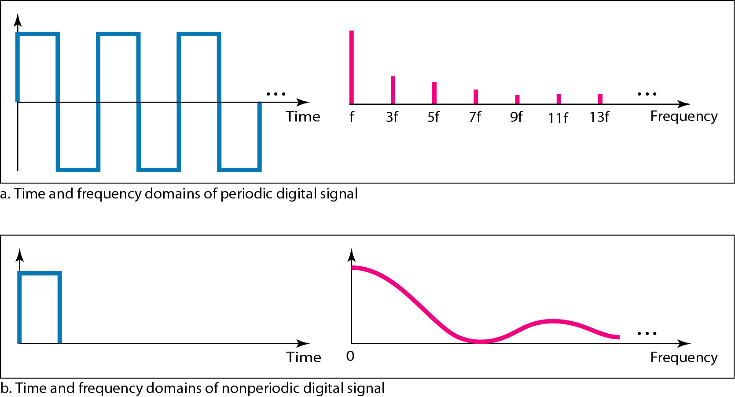
DIGITAL SIGNALS
Digital Signal as a Composite Analog Signal
Fourier analysis can be used to decompose a digital signal.
If the digital signal is periodic, (rare in data communications ), the decomposed signal has a frequency domain representation with an infinite bandwidth and discrete frequencies.
If the digital signal is nonperiodic, the decomposed signal still has an infinite bandwidth, but the frequencies are continuous.
.

Slide 51
Book Referred:
Title: Data Communications And Networking
Author: Behrouz A. Forouzan
Chapter: Chapter 3, Data and Signals

